Slide 1


Slide 2


MarketPulse
Second Year Project Synopsis
Submitted by
Roll No. | Name
2301420060 | Priyanshu
2301420019 | Ansh Vashist
2301420059 | Yash Chauhan
Industry Mentor:
Faculty Mentor: Ms. Neetu
Jatin Dagar
Notes:
New Courses replaced with New Programmes

Slide 3

Project Overview
Digital Idea Force is a marketing agency known for it’s Digital marketing services, social media management, Ads services, and lead tracking. This is a growing startup with strong offline network. We are collaborating with this startup to make a Digital presence for this company and make it scalable and attract online customers with a dynamic website showcasing these services.
Notes:
New Courses replaced with New Programmes

Slide 4
About the Problem
Gaps Researched
No online presence.
Difficulty attracting and engaging potential clients.
High competition in digital space.
Lack of effective SEO, social media, or content strategies.
Inefficient use of digital tools and platforms.
Need for Solution
A comprehensive digital strategy tailored to the agency's goals.
Improved website with optimized UX, mobile responsiveness, and fast load
times.
Effective content marketing to showcase expertise and success.
Strong social media presence and audience engagement.
Notes:
New Courses replaced with New Programmes

Slide 5
Problem Statement
Define the Problem Clearly
The digital marketing agency currently lacks a strong and
cohesive online presence. This results in:
Limited reach to potential clients in their target market.
Missed opportunities to engage with leads through effective
online platforms such as websites, social media, and email
campaigns.
Why is it Important?
Reputation: A strong digital presence is crucial to establish credibility and trust in the
highly competitive digital marketing space.
Client Acquisition: Potential clients often research agencies online before making a
decision; a poor online presence could result in lost opportunities.
Revenue Growth: By engaging more clients online, the agency can increase its
revenue streams through broader exposure and lead conversion..
Notes:
New Courses replaced with New Programmes

Slide 6
Objectives
The goal of this project is to design and develop a professional, user-friendly, and engaging website for Digital Idea Force and online strategy to help tackle its challenges in expanding.
The website will serve as a digital portfolio, showcasing services, case studies, and client testimonials while also providing an easy way for potential clients to get in touch.
Target Audience:
Small and medium-sized businesses looking for digital marketing
solutions.
Entrepreneurs and startups in need of branding and marketing
strategies.
Companies looking for SEO, PPC, social media, and content marketing
services
Notes:
New Courses replaced with New Programmes

Slide 7
Methodology, Tools, and Techniques
Methodology
The development of the Digital Idea Force website follows a structured approach to ensure efficiency and usability:
Service Browsing & Selection: Users can explore categorized marketing services with detailed descriptions, case studies, and pricing. Search and filter options enhance accessibility.
Inquiry & Communication: Clients can submit inquiries or schedule consultations, triggering real-time notifications for prompt responses. Automated emails ensure seamless engagement.
Feedback & Improvement: Post-project feedback is analyzed to enhance services and website features, ensuring continuous evolution.
This approach streamlines service delivery, enhances customer satisfaction, and strengthens Digital Idea Force as a leader in digital marketing.
Tools & Technologies Used
Frontend: HTML , CSS, & js for structure, styling, and responsiveness.
Backend: Php & Mysql for real-time interactions and scalability.
SEO: Screaming Frog for auditing and optimization.
These ensure a seamless, high-performing user experience.
Notes:
New Courses replaced with New Programmes

Slide 8
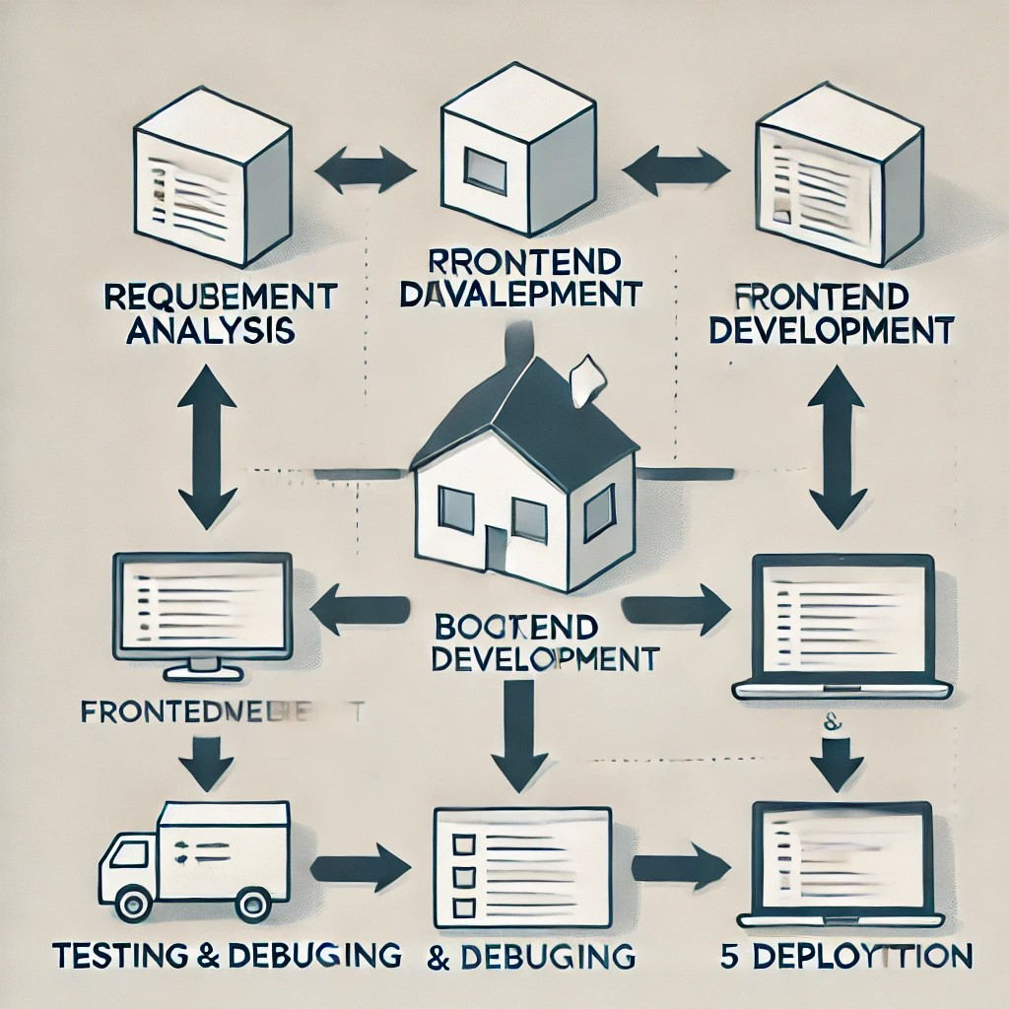
Methodology Flowchart
Notes:
New Courses replaced with New Programmes

Slide 9
Project Timeline
PHASE | TASK | DURATION
Phase 1 | Requirement Analysis | 2 Weeks
Phase 2 | Frontend Development | 4 Weeks
Phase 3 | Backend Development | 4 Weeks
Phase 4 | Testing & Debugging | 2 Weeks
Phase 5 | Deployment & Finalization | 2 Weeks
Notes:
New Courses replaced with New Programmes

Slide 10
Expected Results & Impact
Expected Results:
Enhanced Online Presence – A professionally designed website will improve brand visibility and credibility.
User Engagement & Experience – A user-friendly, visually appealing interface will attract and retain visitors.
Showcasing Services & Case Studies – A structured portfolio will highlight expertise and past successes.
Lead Generation & Client Acquisition – Clear CTAs (Call-to-Actions) will encourage inquiries and conversions.
SEO & Digital Marketing Optimization – Improved search engine rankings will drive organic traffic.
Mobile & Cross-Platform Accessibility – Responsive design ensures accessibility across all devices.
Impacts:
Business Growth – Increased website traffic and engagement will lead to higher client acquisition and revenue.
Client Trust & Credibility – Testimonials and case studies will build confidence among potential customers.
Scalability & Future Expansion – A scalable website structure will allow for future service additions and growth.
Notes:
New Courses replaced with New Programmes

Slide 11
References
Nielsen, J. (2020). User Experience Guidelines for Website Development. Nielsen Norman Group.
Chaffey, D. (2021). Digital Marketing Strategies for Business Growth. Pearson.
Google Developers. (2023). SEO Best Practices and Web Performance Optimization. Google.
SEMrush. (2024). SEO and Website Development Insights. SEMrush Research.
W3C Web Standards. (2023). Web Design and Accessibility Guidelines. World Wide Web Consortium.
Moz. (2024). Search Engine Optimization Techniques and Digital Marketing Strategies. Moz Research.
Notes:
New Courses replaced with New Programmes

Slide 12
THANK YOU

